Slide 1
RESUME CLASSIFICATION
GUIDED BY:
Adhvaith Sir
PRESENTED BY:
Mahesh Renkuntla
Hithindra
Manikandan C
Shreyansh Gaurkar
Shubham Kapadne
Nikhil Hosamani
Aditya Rao

Slide 2


INTRODUCTION RESUME CLASSIFICATION
Resume Classification are programs designed to scan the document, analyze it and extract information important to recruiters. For most HR professionals, important information to be extracted with a resume classification includes skills, work experience, contact information, achievements, education, certifications and certain professional specializations.

Slide 3
OBJECTIVE
Resume classification is a technology that allows you to process online resumes and structure the information by extracting data in an intelligent way. It helps recruiters to efficiently manage electronic resume documents sent via the internet. It extracts essential information like: Contact information, Experience, Skills.
The document classification solution should significantly reduce the manual human effort in the HRM. It should achieve a higher level of accuracy and automation with minimal human intervention
Objective describing position you seek. Profile giving summary of your talents and experience. Experience listing your position, employer and dates.

Slide 4
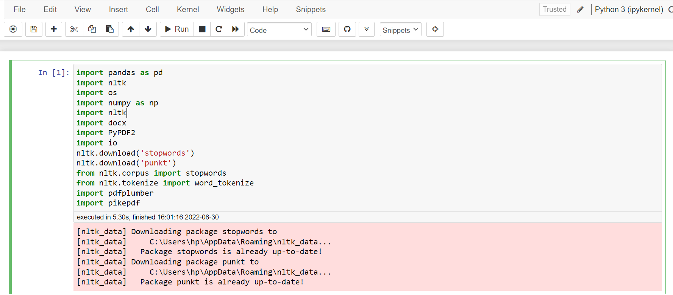
So start with we have to install all the required libraries:

Slide 5
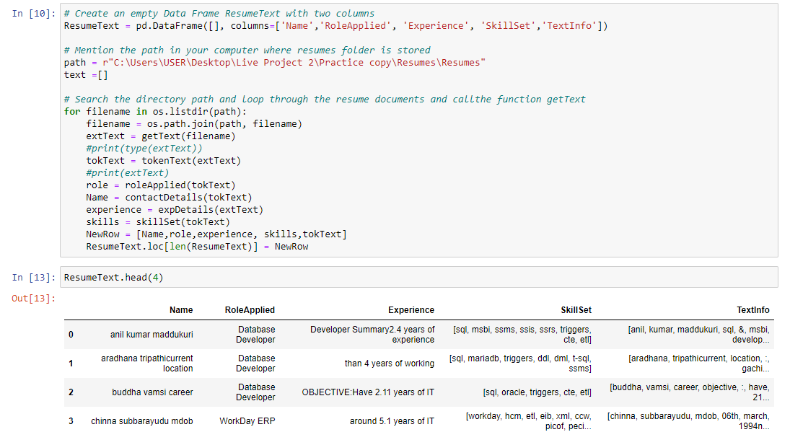
Exploratory Data Analysis (EDA) & Visualization

Slide 6
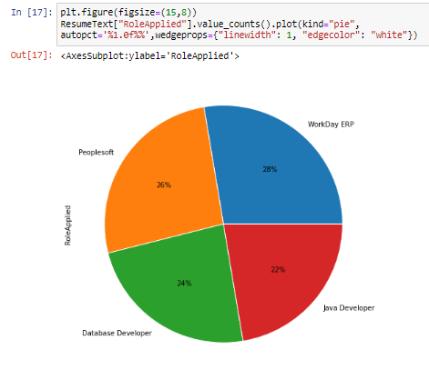
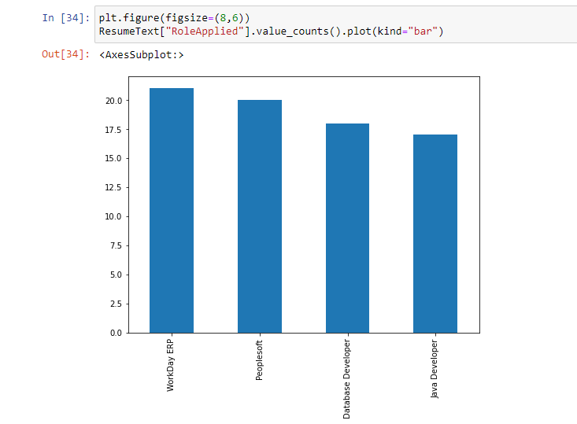

Slide 7
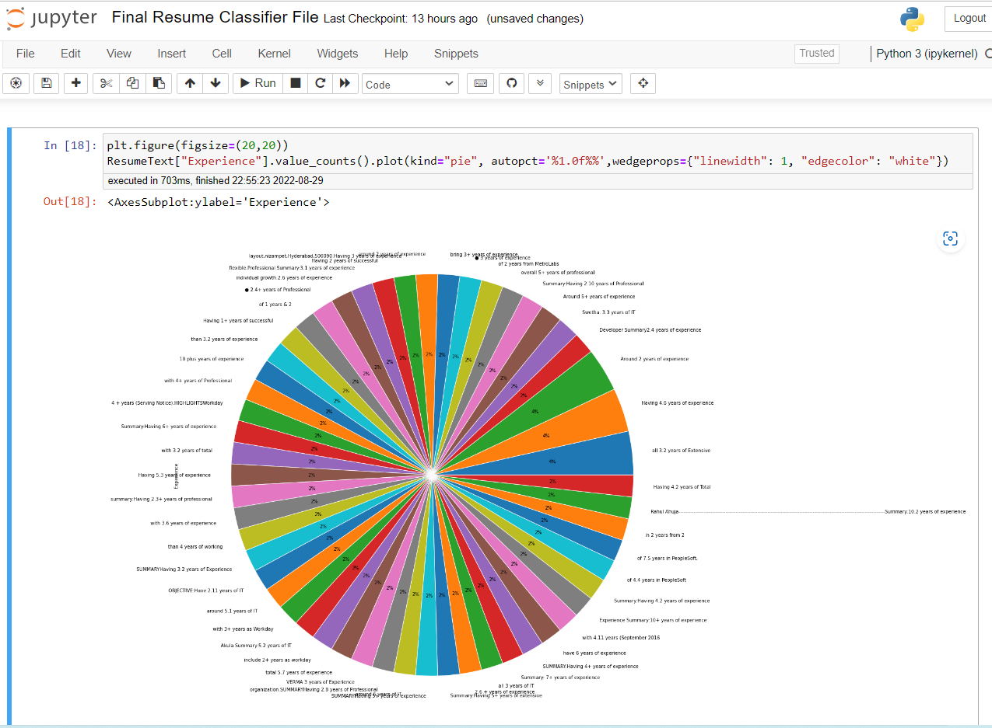

Slide 8
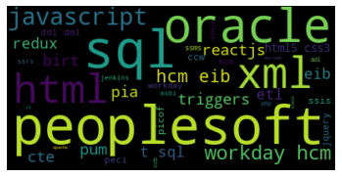
Visualization Generate Word Cloud

Slide 9

Model Building

Slide 10
List of Models Created
K-NEAREST NEIGHBOUR (KNN) CLASSIFICATION
SUPPORT VECTOR MACHINE (SVM) CLASSIFICATION
NAIVE BAYES CLASSIFICATION
DECISION TREE CLASSIFICATION
RANDOM FOREST CLASSIFICATION
Various Models

Slide 11
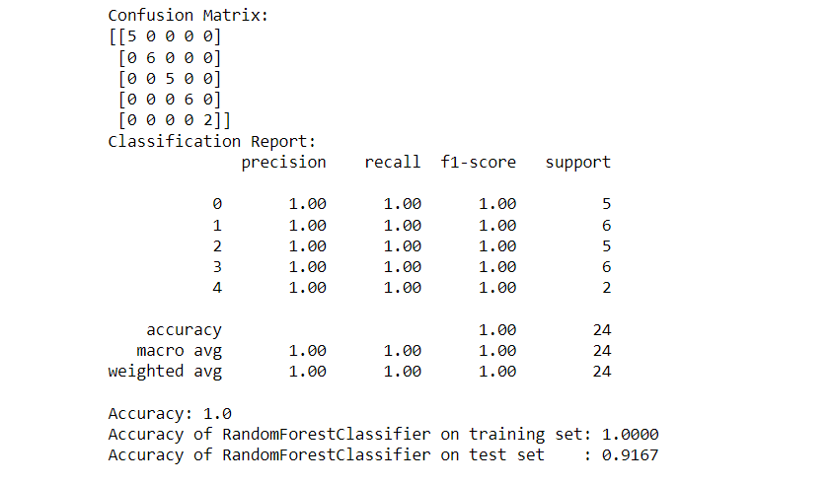
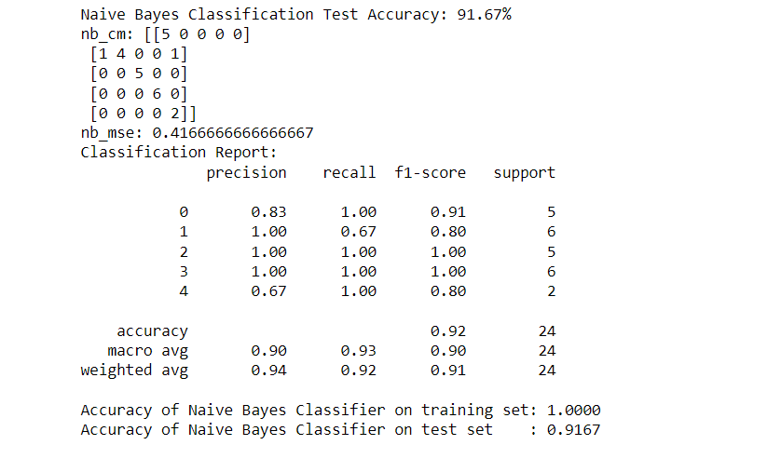
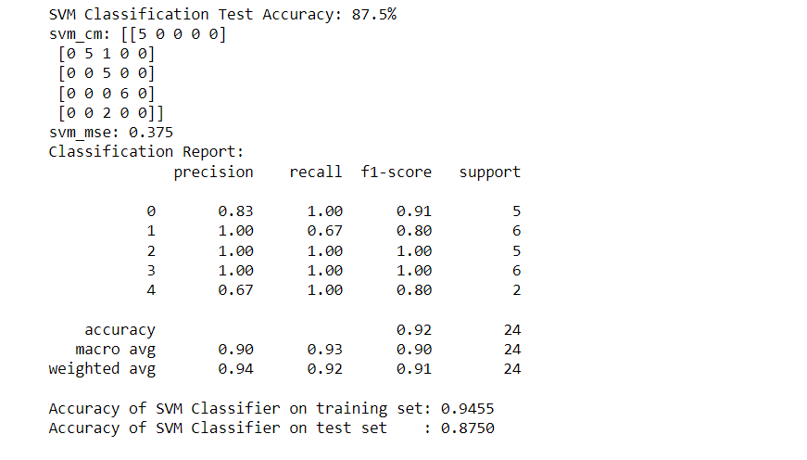
Random Forest Classification
Support Vector Machine (SVM) Classification
Naive Bayes Classification

Slide 12
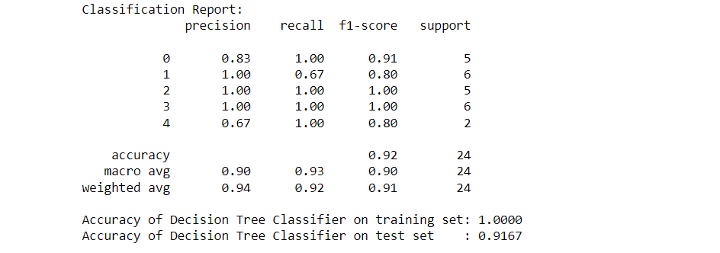
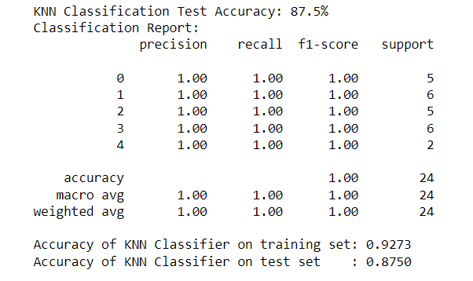
Decision Tree Classification
K-Nearest Neighbour (KNN) Classification

Slide 13
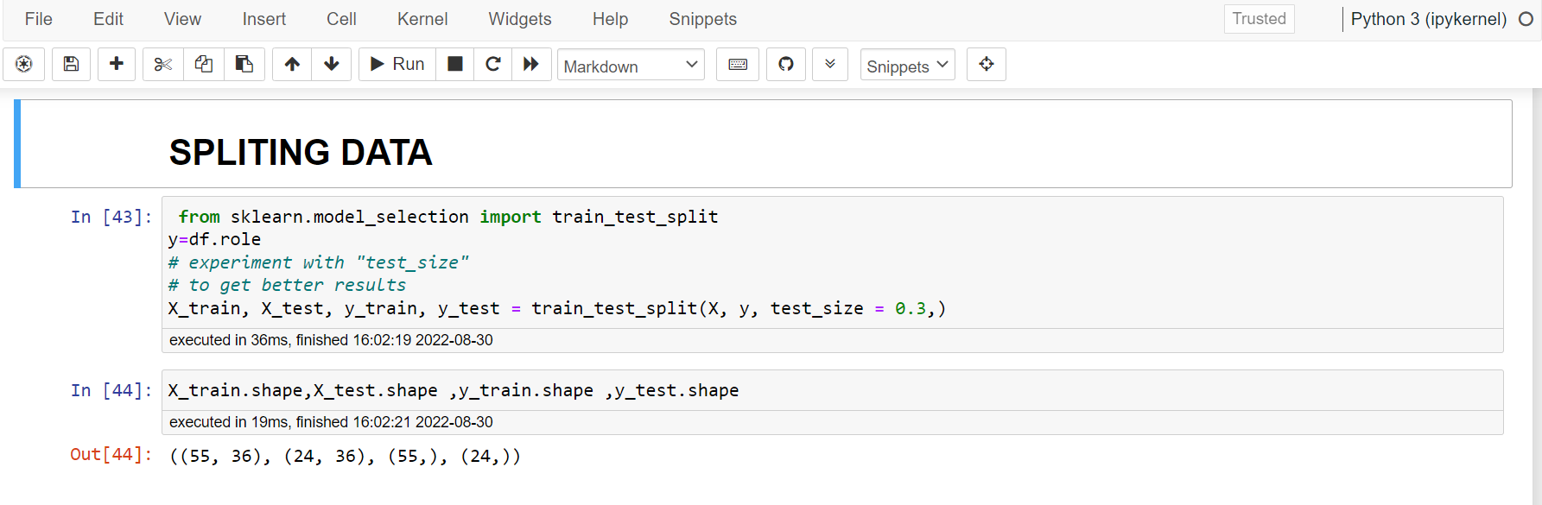
SPLTITING DATA

Slide 14
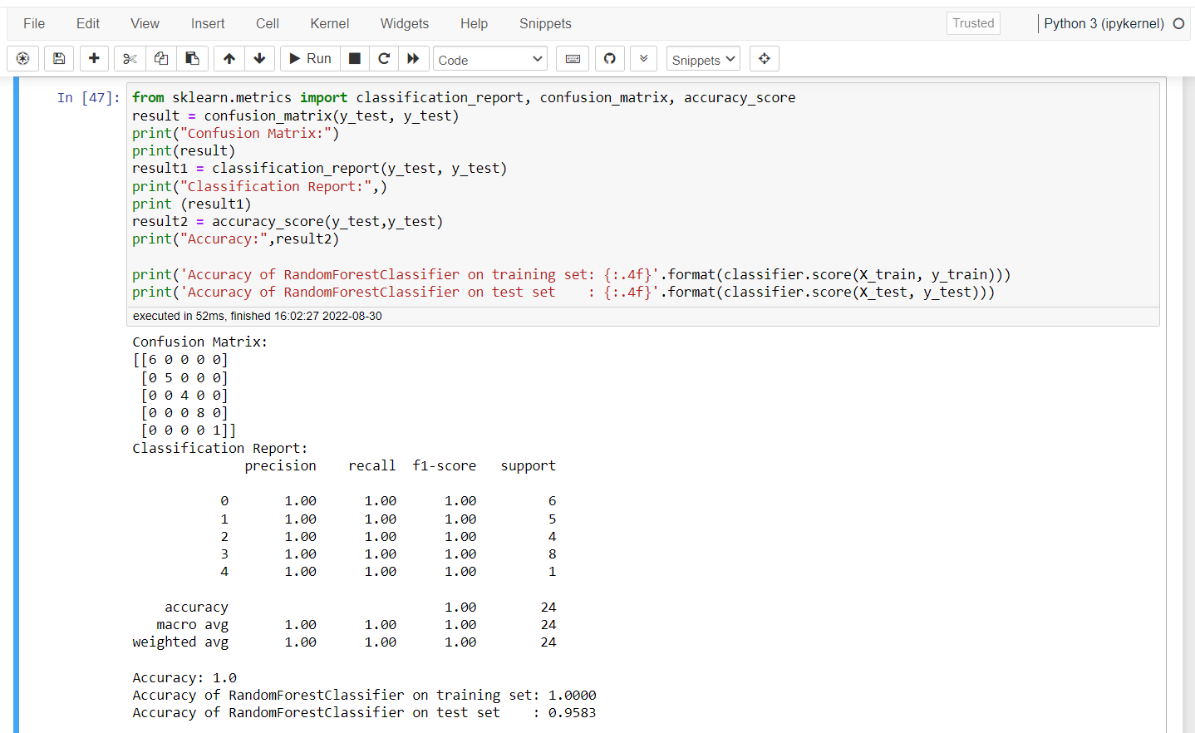
Selected Model : Random Forest Classification
Random forest gives the best accuracy compare to remaining four models
Accuracy of random forest classifier on training set: 1.0000
Accuracy of random forest classifier on test set : 0.9583

Slide 15
DEPLOYMENT
Stream lit is an app framework to deploy machine learning apps built using Python.
Stream lit was used for deployment of model.

Slide 16
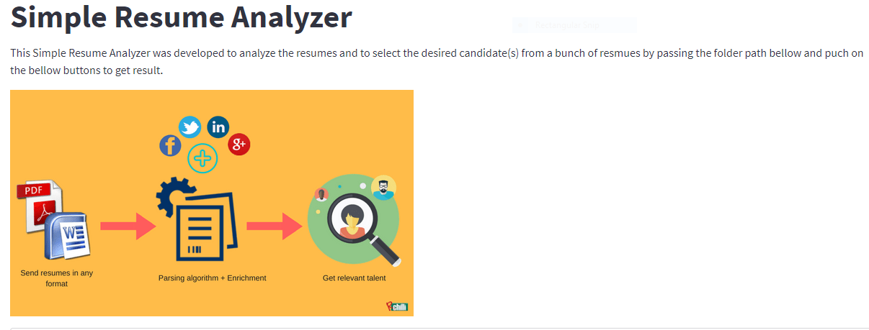
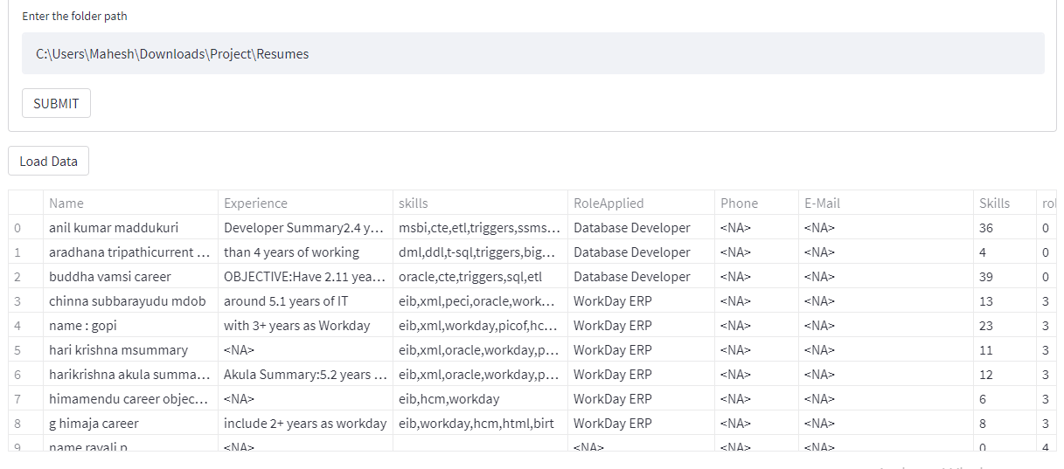
SELECTING FILE IN THE FOLDER

Slide 17
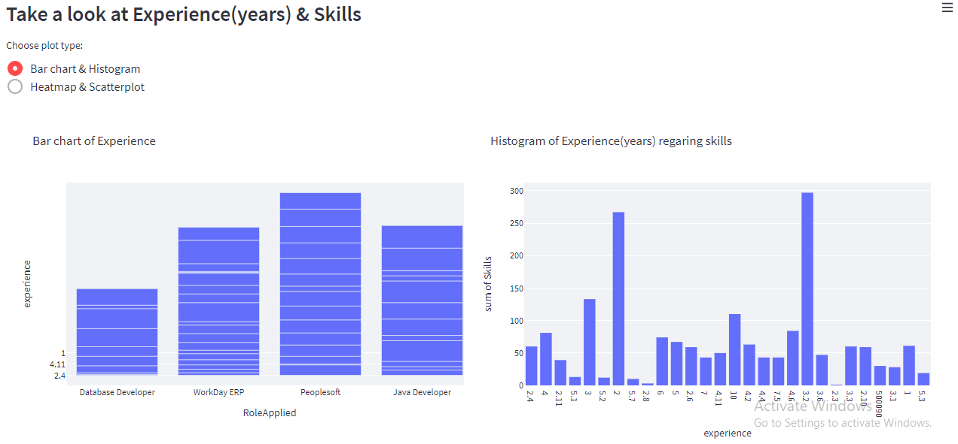
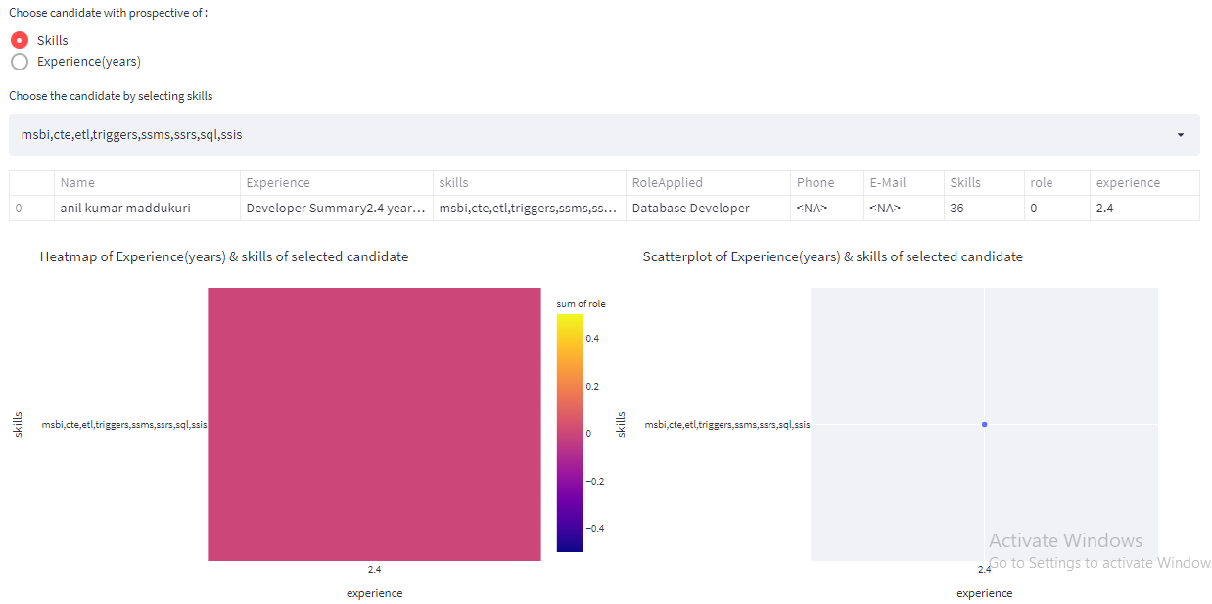
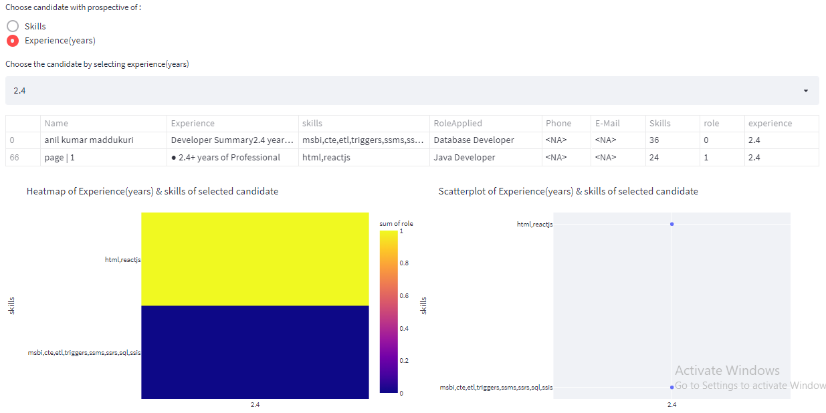
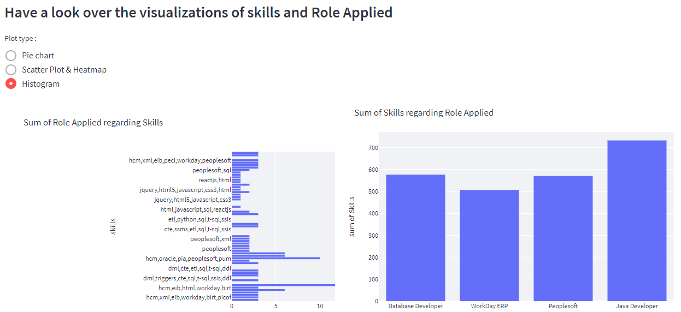

Slide 18
GitHub Links
Mahesh Renkuntla
https://github.com/rmahesh6386/Resume-Classification-Project-
Nikhil Hosamani
https://github.com/nikhillegend/Resume-Classification-Project-
Shubham Kapadne
https://github.com/Shubh2906/Resume-Classifier---NLP
ManiKandam
https://github.com/Mani512996/NLP-PROJECT1.git
Hitendra
https://github.com/hithindra/Resume_Classification_Project
Aditya Rao
https://github.com/AdityaRao09/NLP-Project-Resume-Classifier.git
Shreyansh
https://github.com/champshrey/Resume-Classification.git

Slide 19

THANK YOU

